Slide 1

use of so, too, neither, and either in sentences; modal verbs would and will for request

Slide 2

The different meanings of so
So expresses consequence, with the general meaning of therefore
So expresses purpose, with the meaning of in order that
So expresses addition, with the general meaning of and also
So expresses a degree; it is an intensifier with a meaning similar to very
So expresses agreement or confirmation, with a general meaning of "it is true" or "it is the case".

Slide 3
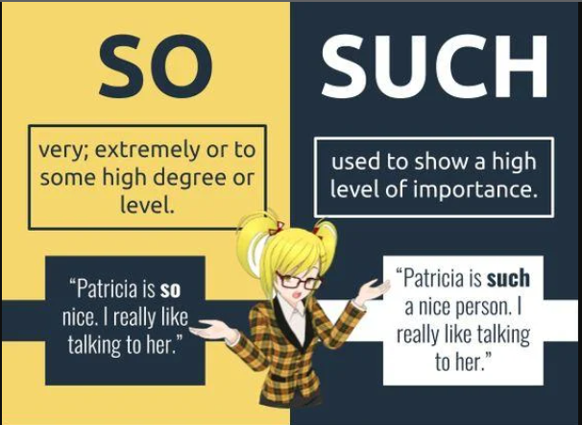
Difference Between So and Such

Slide 4

Difference Between So and Such

Slide 5
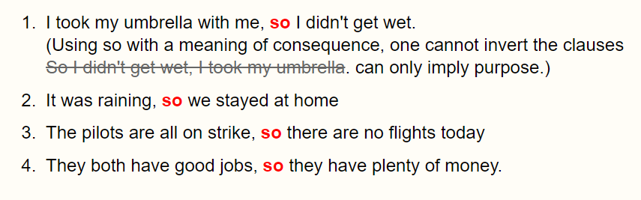
So Expressing Consequences

Slide 6

In these cases above, ‘so’ is a conjunctive adverb expressing a consequence. (Some grammar books consider it to be a coordinating conjunction)
This is the fundamental meaning of so as a connector. The coordinated clause of consequence must follow the main clause.
In example 1 above, you might imagine that there could be an ambiguity between consequence and purpose; but this is not ambiguous for English-speakers.
A so clause following a main always expresses consequence unless it refers to future time. (Compare with example 1 below).

Slide 7
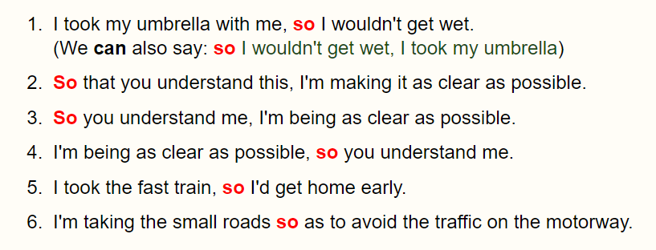
So Expressing Purpose

Slide 8
In this case, so is a subordinating conjunction, expressing a purpose. It can either be used alone, or else in the expression so that.
The subordinate clause of purpose can either precede or follow the main clause.
So that is usually preferred if the subordinate clause of purpose comes before the main clause.
so, by itself, is mostly used to introduce clauses of purpose when they refer to future time, or relative future time (examples 1 and 5), as in these cases the meaning of so cannot be ambiguous. It must mean purpose, not consequence. Compare examples 1 (consequence) and 1 (purpose) .

Slide 9
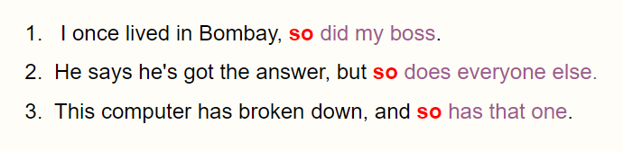
So Expressing Addition

Slide 10
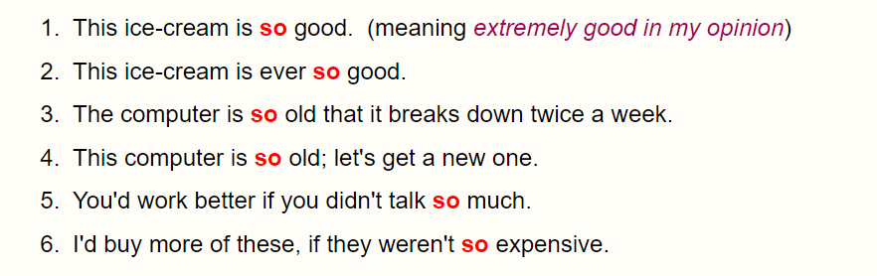
So Expressing degree

Slide 11
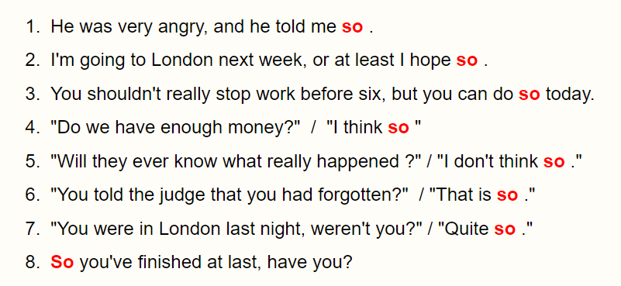
So Expressing Agreement or Confirmation

Slide 12
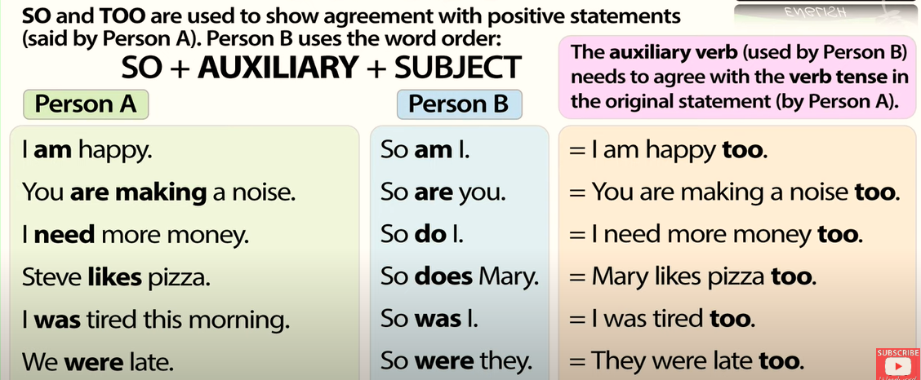
Difference Between So and Too

Slide 13
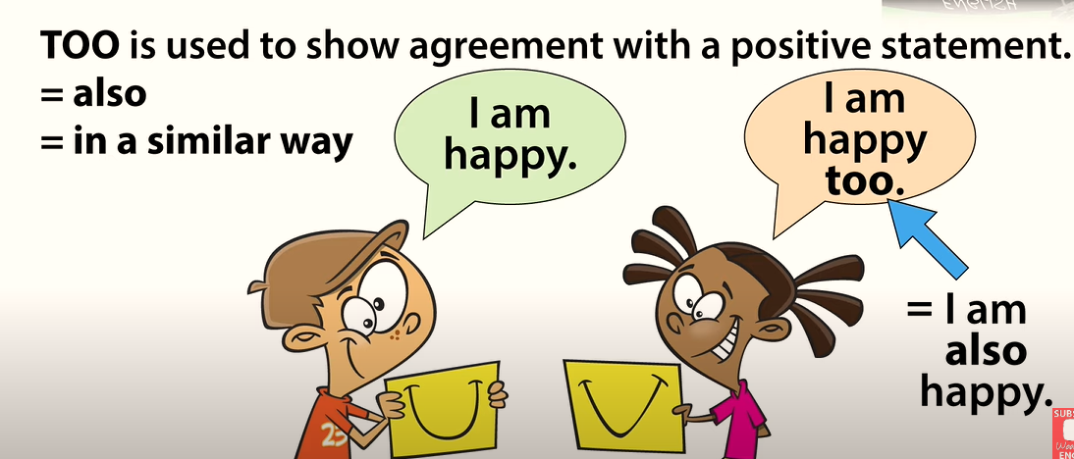
Using Too

Slide 14
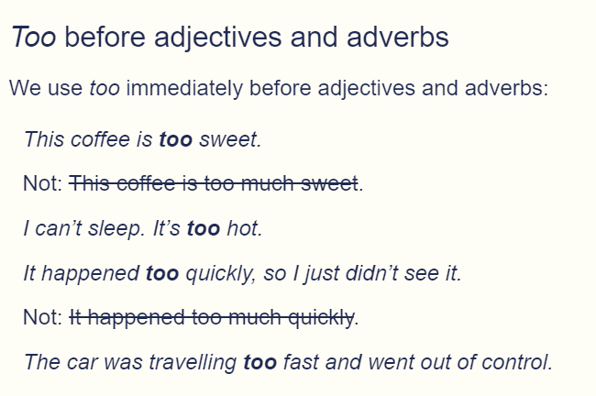
Too meaning ‘more than enough’

Slide 15
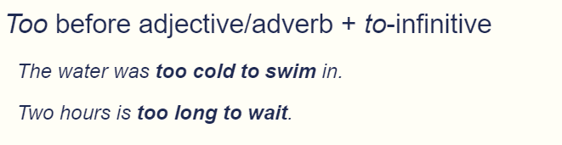
Too meaning ‘more than enough’

Slide 16
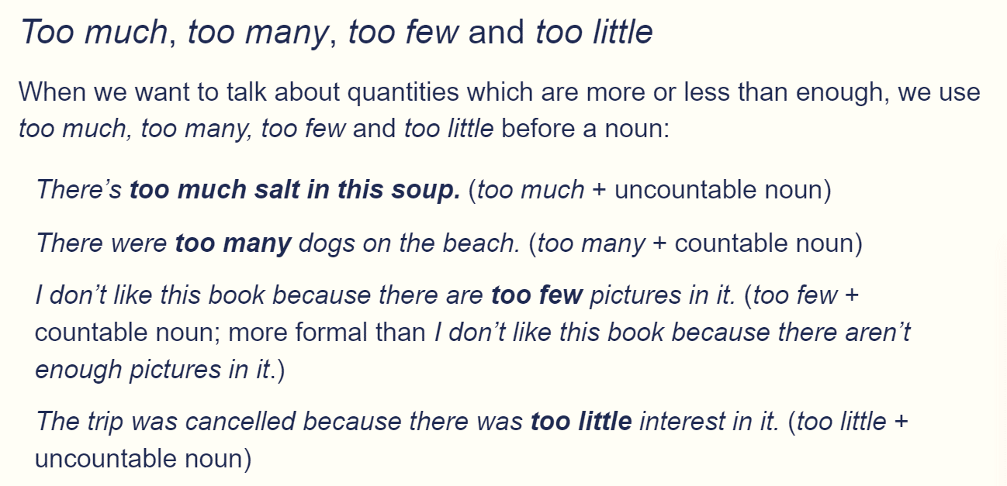
Too meaning ‘more than enough’

Slide 17
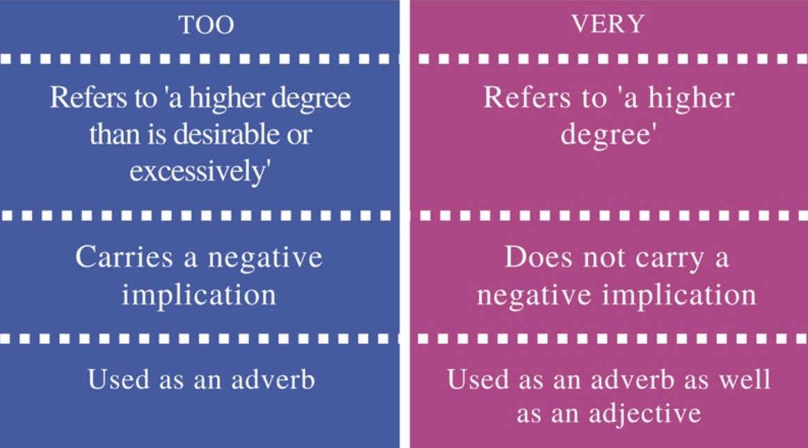
Difference Between Too and Very

Slide 18
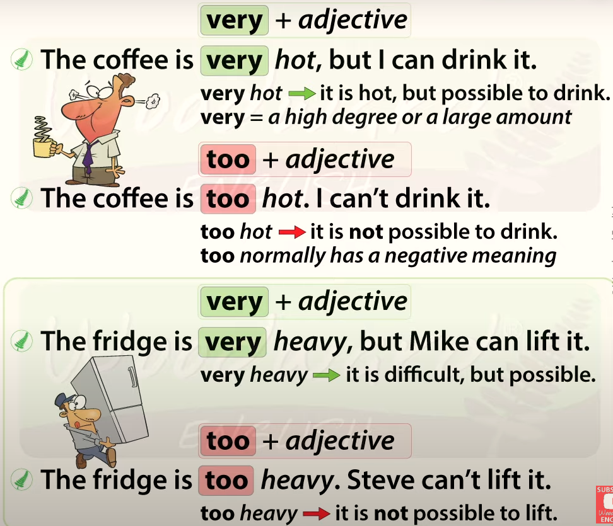

Slide 19
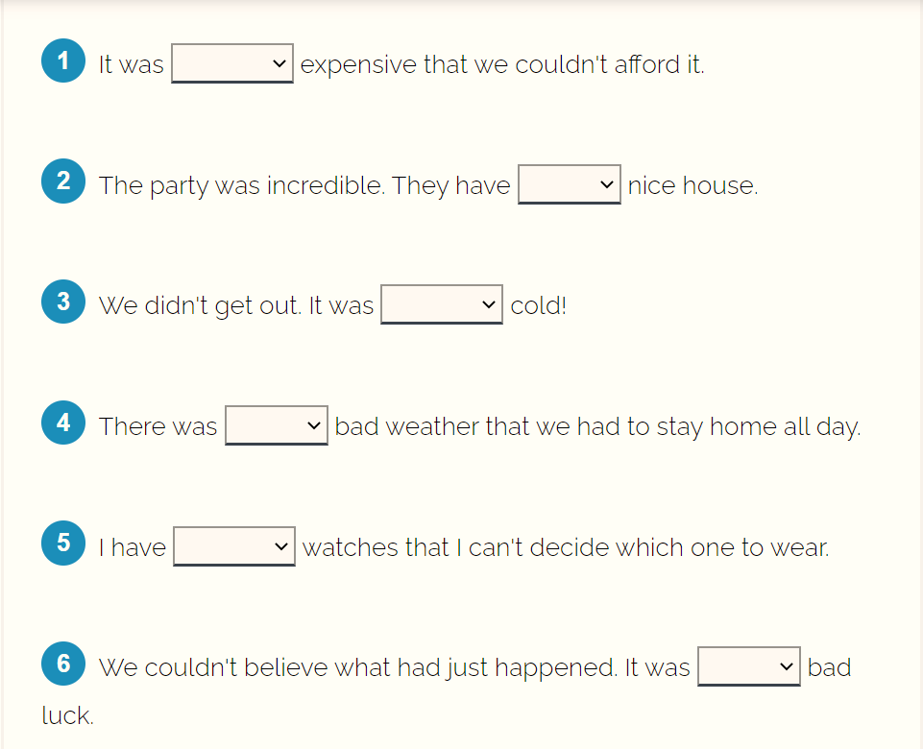
Practice

Slide 20
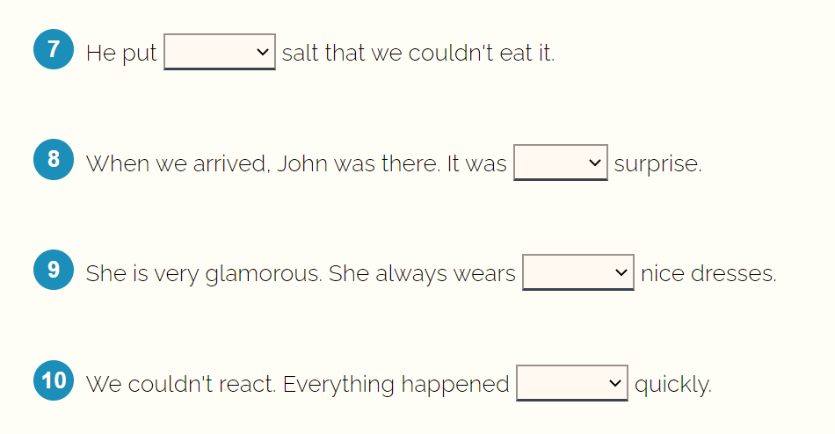
Practice

Slide 21
Practice
Correct answer: so ➪ We use so + adjective/adverb. ➪ We can say so + adjective/adverb + (that) + subject + verb.
Correct answer: such a ➪ We use such a + singular countable noun to mean 'really': They have such a nice house (=a really nice house).
Correct answer: so ➪ We can use so + adjective/adverb to mean 'really': It was so cold =really cold.
Correct answer: such ➪ We say such + (adjective) + plural noun or singular uncountable noun: They are such nice people. ➪ We can say such + (adjective) + plural noun or singular uncountable noun + (that) + subject + verb: I am in such pain that I can't move. ➪ The word weather is uncountable.
Correct answer: so many ➪ We say so many + plural noun + (that) + subject verb to mean 'too many’.

Slide 22
Practice
Correct answer: such ➪ We say such + (adjective) + plural noun or singular uncountable noun: They are such nice people. ➪ The word luck is uncountable.
Correct answer: so much ➪ We can use so much + uncountable noun + (that) + subject + verb to mean 'too much’.
Correct answer: such a ➪ We use such a + singular countable noun to mean ‘great’: It was such a surprise (=a great surprise).
Correct answer: such ➪ We say such + (adjective) + plural noun or singular uncountable noun to mean 'really': They are such nice people (=really nice).
Correct answer: so ➪ We use so + adjective / adverb to mean 'really'.

Slide 23
Use of Neither
Neither allows us to make a negative statement about two people or things at the same time.
Neither goes before singular countable nouns. We use it to say ‘not either’ in relation to two things.
Neither can be pronounced /ˈnaɪðə(r)/ or /ˈni:ðə(r)/.
We use neither of before pronouns and plural countable nouns which have a determiner (my, his, the) before them
In formal styles, we use neither of with a singular verb when it is the subject. However, in informal speaking, people often use plural verbs

Slide 24
Use of Either
We can use either as a determiner before a noun to talk about two choices or possibilities. The noun that follows either must be a singular countable noun.
Either must be followed by of if we use it before the, these, those or possessives (my, your) with a plural noun
Either as a determiner before a singular countable noun can mean ‘both’ – “There were shops on either side of the street.”
“Personally, I don’t like either jacket.”
“Either of the children can come with us; we don’t mind which.”

Slide 25
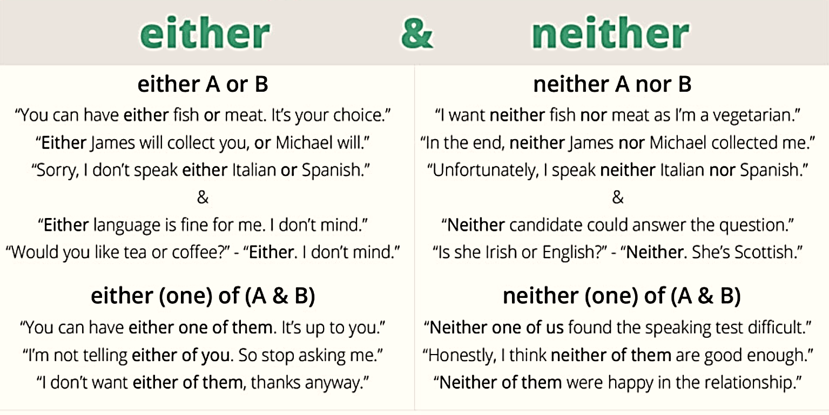

Slide 26
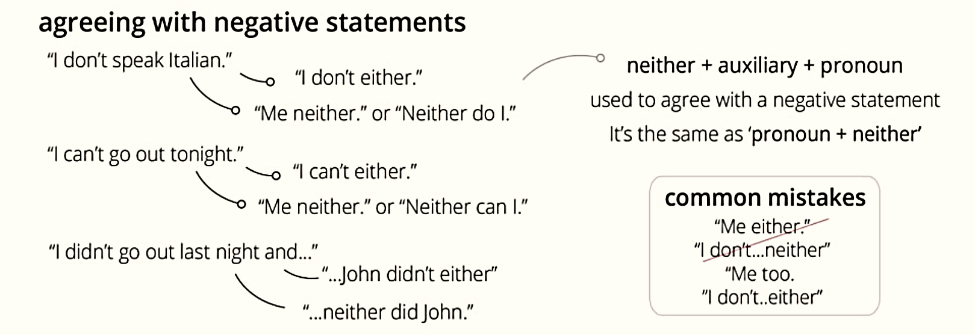

Slide 27
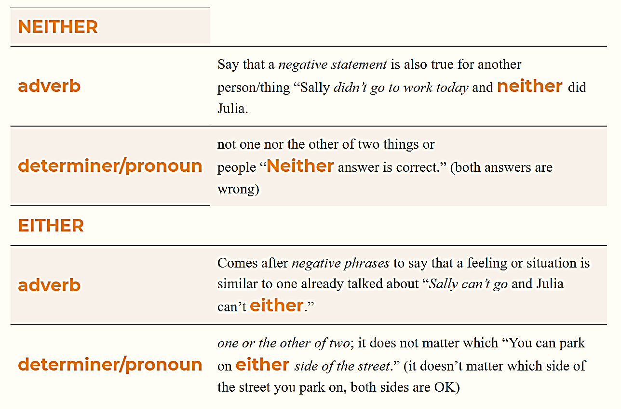

Slide 28

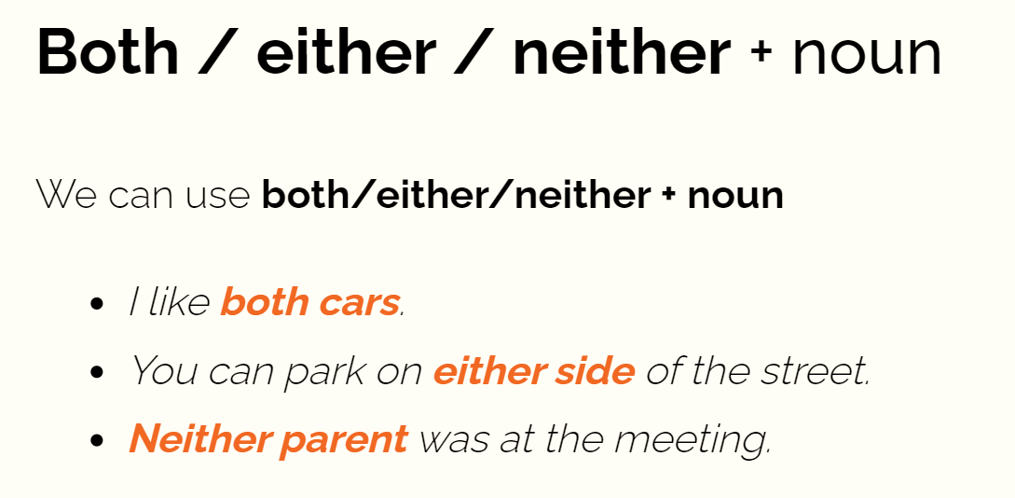

Slide 29
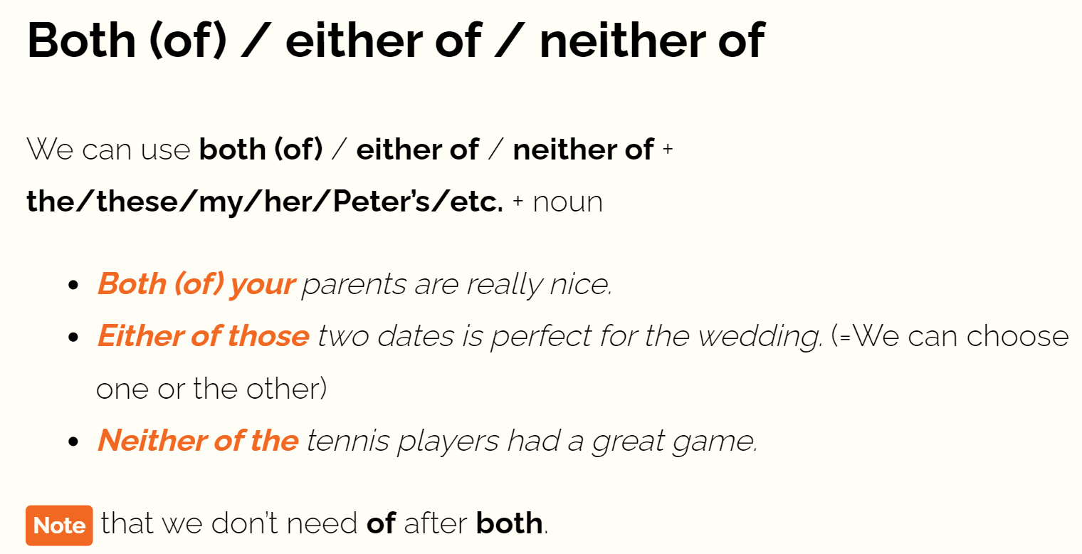

Slide 30
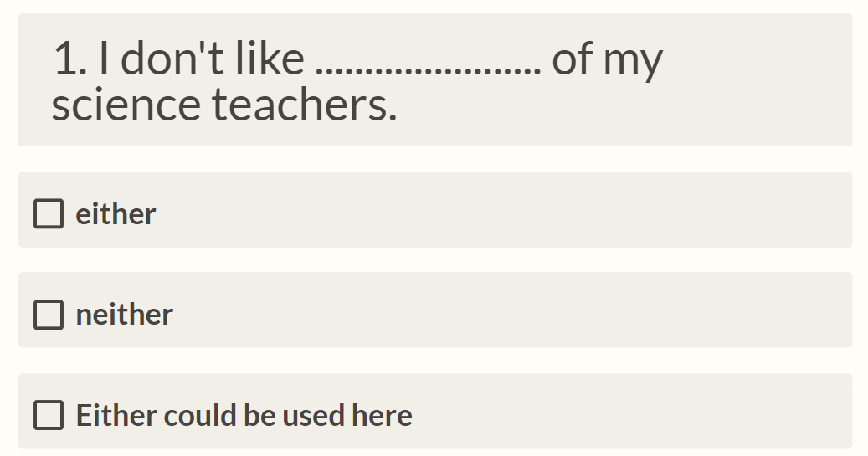
Quiz

Slide 31
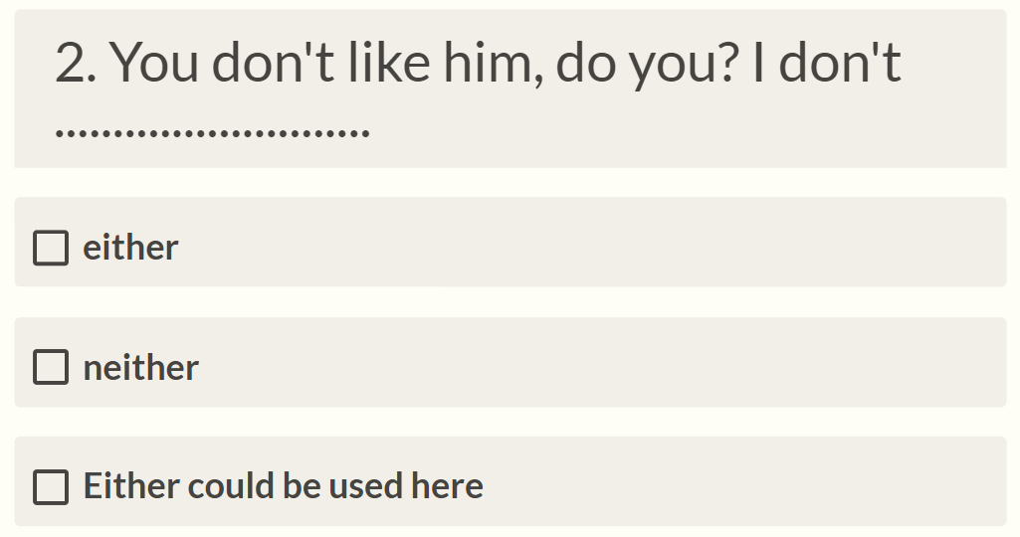
Quiz

Slide 32
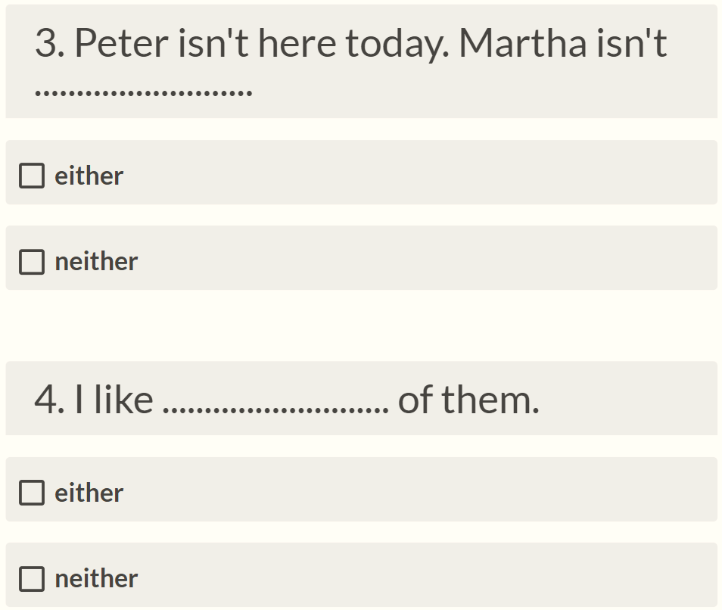
Quiz

Slide 33
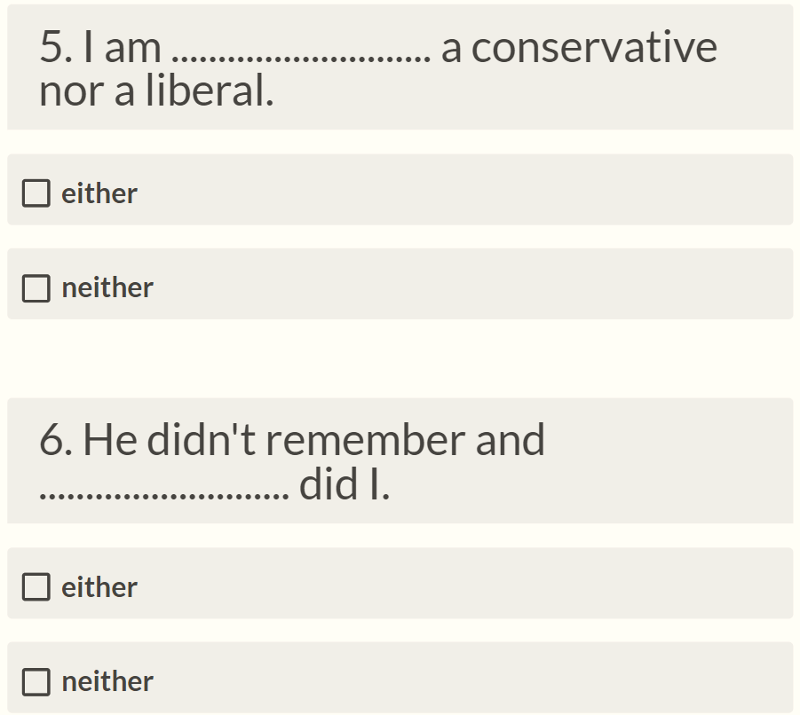
Quiz

Slide 34
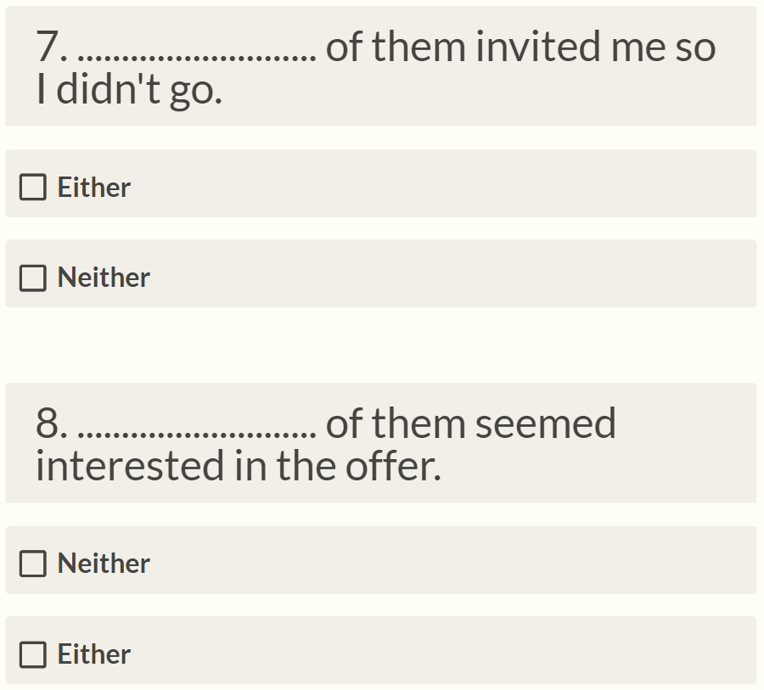
Quiz

Slide 35
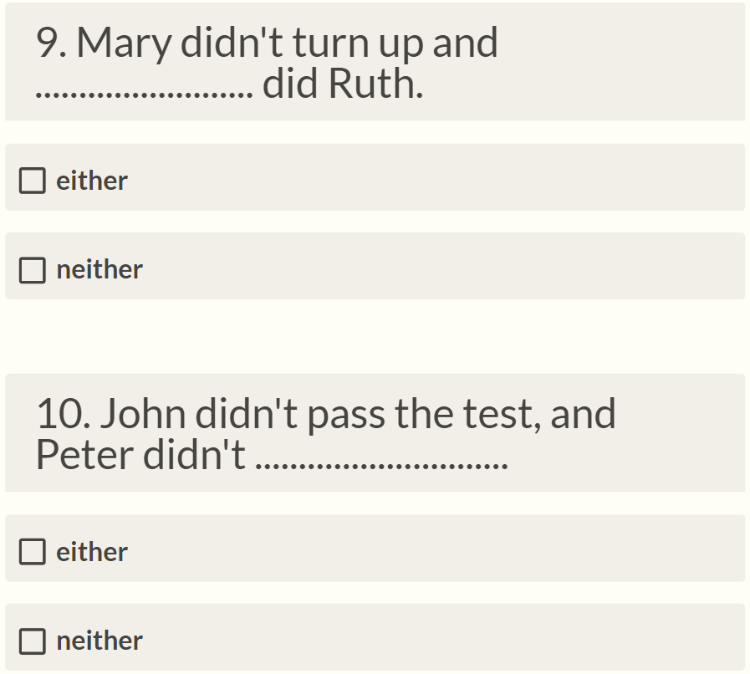
Quiz

Slide 36
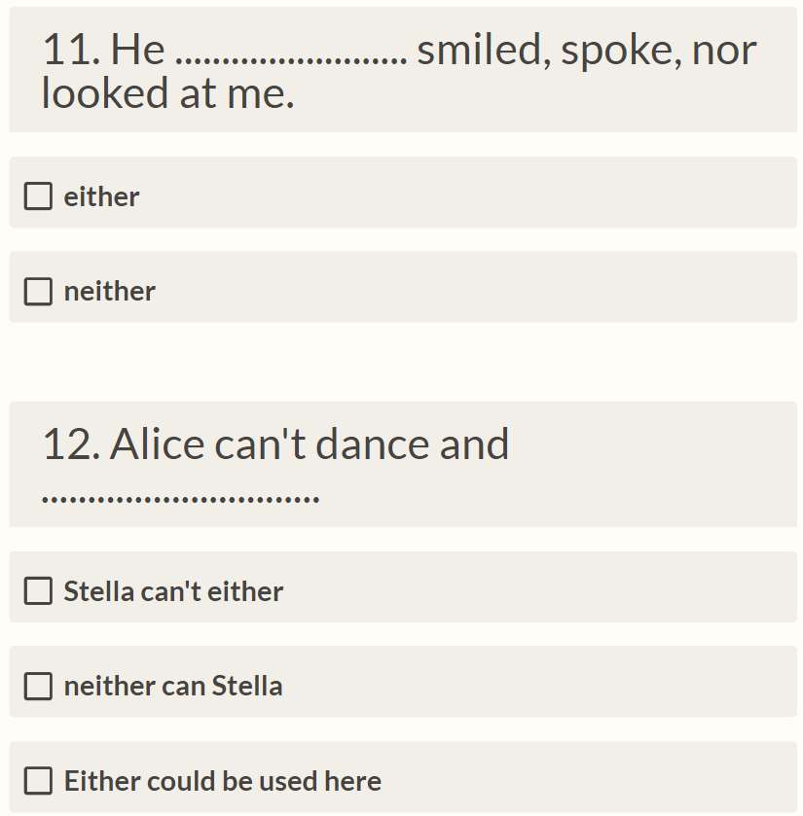
Quiz

Slide 37
Answers
I don’t like either of my science teachers. 2. You don’t like him, do you? I don’t either. 3. Peter isn’t here today. Martha isn’t either. 4. I like neither of them. 5. I am neither a conservative nor a liberal. 6. He didn’t remember and neither did I. 7. Neither of them invited me so I didn’t go. 8. Neither of them seemed interested in the offer. 9. Mary didn’t turn up and neither did Ruth. 10. John didn’t pass the test, and Peter didn’t either.
11. He neither smiled, spoke, nor looked at me. 12. Alice can’t dance and neither can Stella / Stella can’t either.

Slide 38
Difference Between Will and Would
We use will:
would is the past tense form of will. Because it is a past tense, it is used:
to express beliefs about the present or future
to express beliefs about the present or future
to talk about what people want to do or are willing to do
to make promises, offers and requests.
to talk about the past
to talk about the past
to talk about hypotheses (when we imagine something)
for politeness.

Slide 39
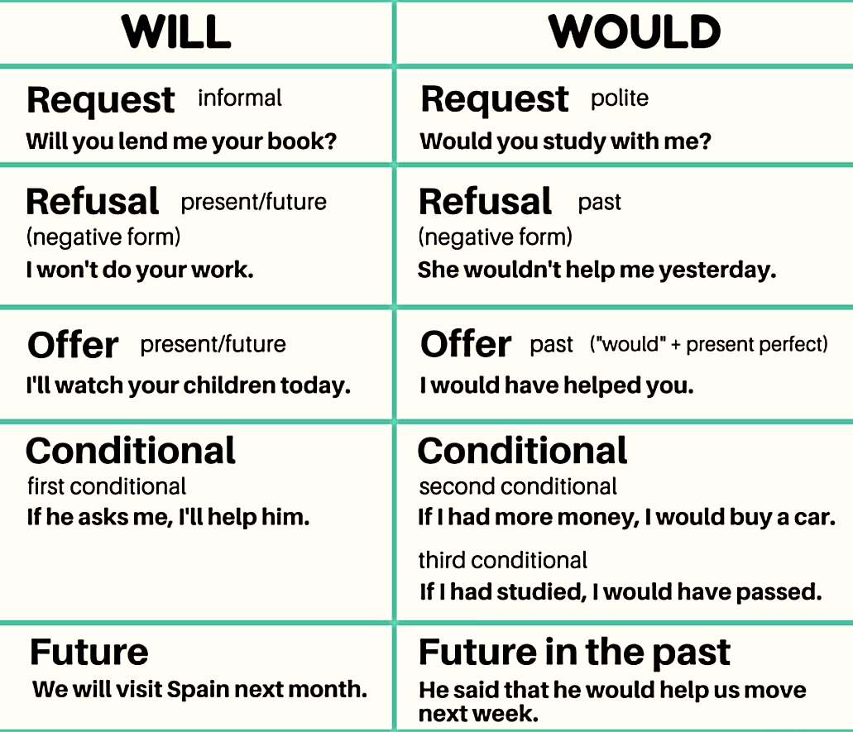

Slide 40

THANK
You

